Slide 1
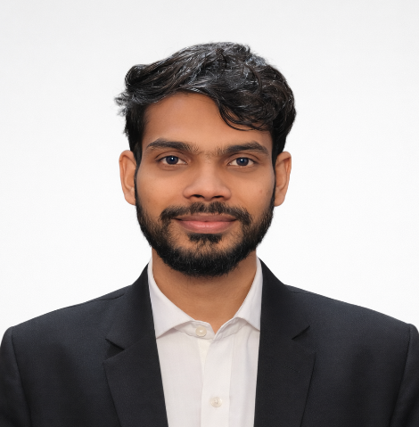






MD. SAGOR HOSSAIN
DIGITAL MARKETING EXPERT
PROFILE
Digital marketing professional based in Dhaka, Bangladesh, specializing in SEO, Google Ads, Meta Ads, and Google Analytics 4. Currently Senior Executive, Digital Marketing at Maktech, with prior experience in SEO consulting and ICT training. Skilled in Google Business Profile optimization, Google Tag Manager, and WordPress/Shopify SEO, with a strong interest in teaching digital marketing to others.
CONTACT
01610077477
itsagorhossain@gmail.com
WORK EXPERIENCE
Dhaka, Bangladesh
Maktech
Mar 2025 - Present
sagorhossain.com
Senior Executive, Digital Marketing
  Plan and execute SEO, Google Ads, and Meta Ads campaigns to drive organic and paid traffic growth.
  Manage Google Analytics 4 (GA4) and Google Tag Manager (GTM) setups to track performance and optimize conversions.
  Optimize Google Business Profiles and WordPress/Shopify SEO to strengthen local and organic visibility.
SKILLS
  SEO
  Google Ads
  Google Business Profile Optimization
  Meta Ads
  Google Analytics 4 (GA4)
  Google Tag Manager (GTM)
  WordPress SEO
  Shopify SEO
Crystal Vision Solutions
Apr 2024 - Feb 2025
SEO Expert
  Conducted technical, on-page, and off-page SEO audits to improve client search rankings.
  Researched keywords and competitors to build data-driven SEO strategies.
ICT Division, Bangladesh
Mar 2023 - Jan 2024
ICT Trainer, Training of Trainers (ToT)
LANGUAGES
  Delivered Training-of-Trainers (ToT) sessions on ICT and digital skills to government trainers.
  Developed training materials and curriculum content for digital literacy programs.
  Bengali (Native)
  English (Fluent)
EDUCATION
REFERENCE
[Degree/Program - please confirm]
2023
Dhaka International University (DIU)
Available upon request
Diploma in Engineering
2022
Shariatpur Government Polytechnic Institute

